Slide 1
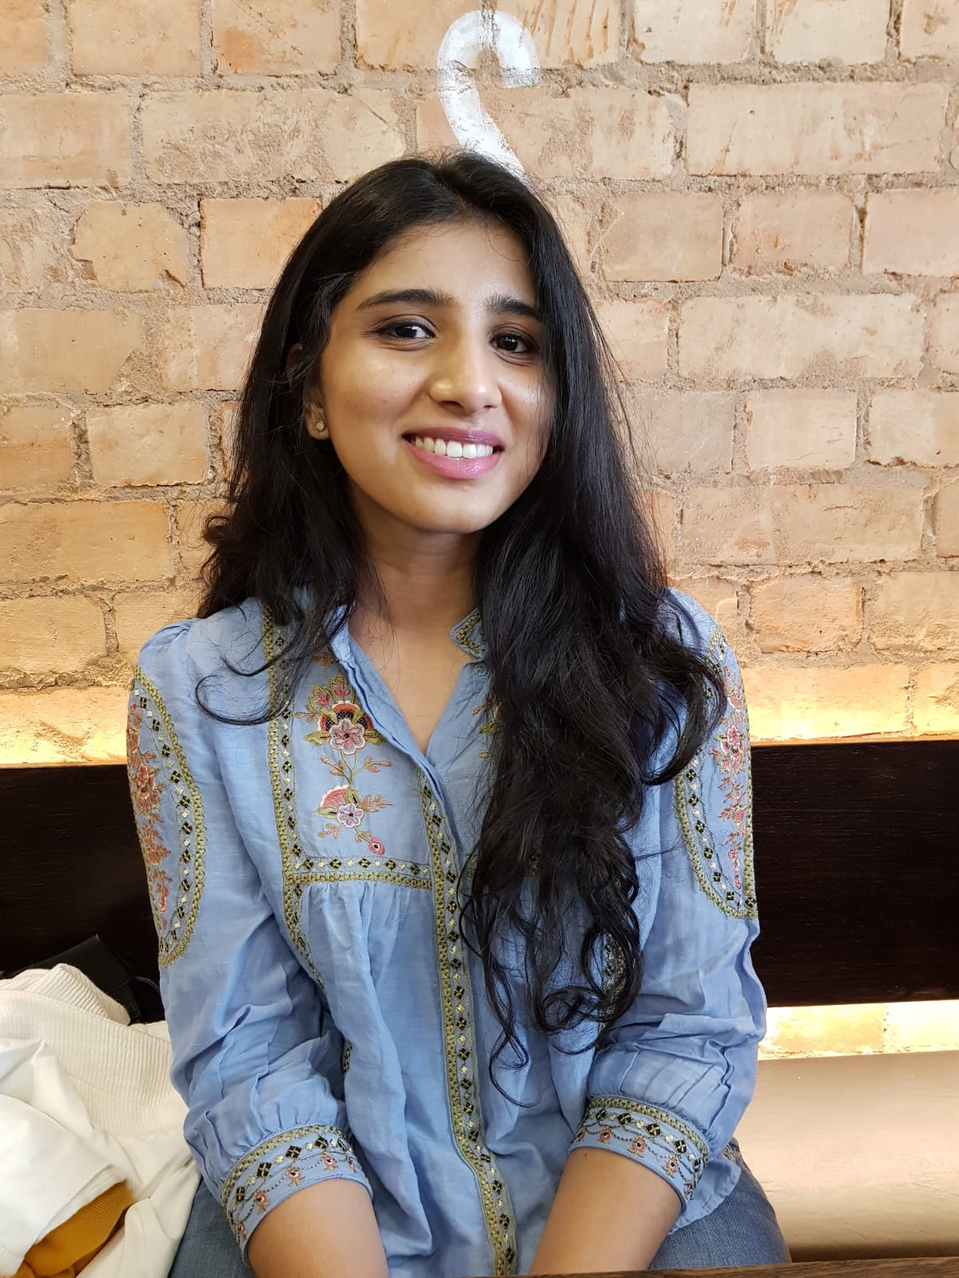
The RADiANT Research Observership
The opportunity to be an observer of research activity is an initiative from the RADIANT network and the Leicester Centre of Mental Health Research.
It is aimed at graduates from any background who have an interest in the mental health of people with developmental disorders and research in that area.
The observership offers a mentoring relationship with clinician academics who are part of the RADIANT network.
The observer will get an introductory overview of research and can aim to understand the following:
Definitions of research, audit and service evaluation
The structure of research activity within the NHS and universities in the UK.
Funding sources and the NIHR (National Institute of Health Research)
Career pathways as a researcher and the skill sets that are needed.
Familiarisation with the mentor's research activities and future projects.
Observing activities that disseminate research findings (e.g.: presentations, conferences, etc) and networking opportunities with clinical research leaders.
Elizabeth Patteril was the first research observer with RADiANT. A dental graduate from Palacky University, Czech Republic, she started her observership based at Little Plumstead Hospital in April 2022. Apart from receiving an introduction to the world of research, audit and service evaluation, she learned about how to carry out a literature search and how to structure a research paper. Elizabeth now works as a Research Assistant in the neurodevelopmental research stream of Hertfordshire Partnership University NHS Foundation Trust and is involved in several peer reviewed publications.
Medha Cherukat, the current RADiANT research observer started in June 2023 and is an undergraduate psychology student at Birmingham University. She is currently working with her mentor to review thyroid disorders in people with neurodevelopmental disorders.

